Slide 1
Session 7
Advanced Windows Forms Features

Slide 2
Review
GDI+ provides the basic functionality to implement graphics in WinForms. GDI+ resides in System.Drawing.dll assembly.
The Graphics class is present in the System.Drawing namespace. It cannot be inherited.
The CreateGraphics() method is used to create the Graphics object. It is a method of the Control class.
Graphics objects can also be created from any object that derives from the Image class. This is done by using the FromImage() method of the Graphics class:
The Pen object can be used to specify fill styles for objects. The Pen class belongs to the System.Drawing namespace and cannot be inherited.
The Brush class is used to fill shapes with solid color. It is abstract and belongs to the System.Drawing namespace.
The Color structure is used to create or use colors for graphics in GDI+. It has various color names as its members which can be invoked to display particular colors.

Slide 3
Review Contd…
The DrawLine() method of the Graphics class is used to draw a line on the screen.
The DrawString() method of Graphics class is used to display text on the screen without using any text related controls.
The DrawImage() method of Graphics class is used to draw image files on the screen
System.Drawing.Drawing2D namespace includes the gradient brushes, Matrix and GraphicsPath classes to provide the functionality of 2-dimensional and vector graphics.
The PrintDocument class is used for printing GDI+ objects. This class is defined in the System.Drawing.Printing namespace.
System.Drawing.Text namespace contains the TextRenderingHeight enumeration which is used to define the mode of the rendered text.

Slide 4
Objectives
Create Simple Custom WinForms Controls
  Add properties to WinForms Controls
  Associate events with WinForms controls
  Inherit from the existing WinForms Controls
Handle mails in WinForms
Associate Help files with an application
Package and deploy an application

Slide 5
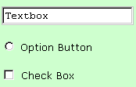
Introduction
Additional
features
WinForms
Provides
normal
controls
+
Radio Button
Custom Controls
Control
1
Control
2
Used as Normal Control
in other applications
Composite Custom Controls
Own properties and controls

Slide 6
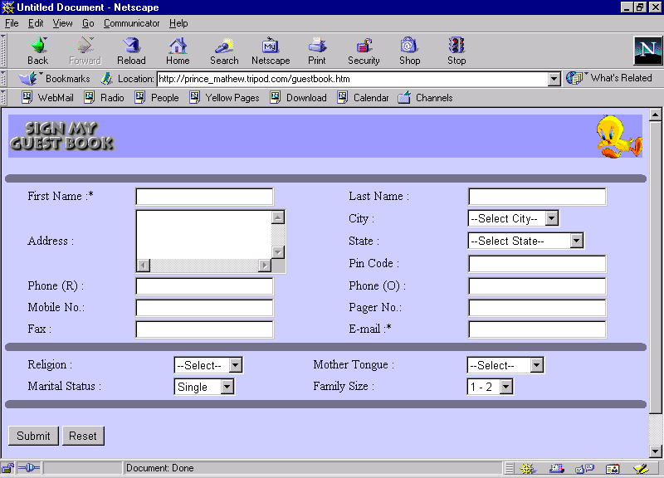
Developing a Custom control
Derived from UserControl or Control class or an
existing Windows Forms control
Custom
Controls
along
with
Methods
Properties
Member Variables
Methods
Tasks the user wants
the control to execute
Provides
GUI
offers
Properties and
member variables
Data a user of the
control can get or set
Backend
functionality

Slide 7
Steps to Author a User Control
Open a new Windows Application
Add User Control
Add controls from the Toolbox for the user control
Write code in event procedures
Save the file
Close the designer for the user control
Build the project
Add the user control to any windows form

Slide 8
Using the Custom Control
To use the custom control in any other application:
  A Control Class Library has to be created
  The library has to be included in the application
To create control class library:
  Create a new Windows Control Library project
  Add controls and code
  Build the DLL
  DLL to be incorporated in the application

Slide 9
Adding Properties to User Control
To define a property:
1
  Define a private data member
      private string str;
  Define a public property
      public string MyString
      {
        get{ return str; }
        Set{ str=value; }
      }
2

Slide 10
Changing the Properties of Constituent Controls
Create a public property.
In the get() method of the property, write code that retrieves the value of the required property.
In the set() method of the property, write code that assigns a value passed through the public property to the property of the constituent control.

Slide 11
Associating Events with
User Controls
Events act as a bridge between the application and
the user
C# uses delegates to bind events to methods
Delegates allow other classes to register for event notification
.NET framework has guidelines for defining the events of a component

Slide 12


Event definition in C#
Publisher first defines a delegate
Publisher then defines an event based on the delegate
Subscribing an event to an object depends on whether the event exists
  If event exists, subscribing event adds a delegate that calls a method when the event is raised

Slide 13
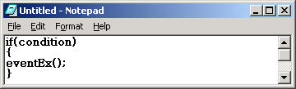
Event definition in C# Contd…
Raising an event notifies all the objects subscribed to that event
Syntax for raising an event is the same as calling a method
If none of the objects have a subscriber to an event when it is raised, an exception is thrown

Slide 14
Inheriting from existing WinForms controls
Inherit a control to extend functionality of the new control
Functionality can be changed by implementing custom methods and properties

Slide 15
Inheriting from existing WinForms controls Contd…
New
Windows Project
Add
inherited control
Select
Custom Control
1
2
3
Change name
of base class
For eg: (for Button)
public class Custom_Control1 : System.Windows.Forms.Button
4
Override the onPaint method to
modify visual appearance
Implement any
custom method or properties
6
5
protected override void OnPaint(PaintEventArgs pe)
{ base.OnPaint(pe); }
Save and test
your control
7

Slide 16
Inheriting from a
User Control Class
Used when functionality of one or more Win Forms controls have to be combined
The interface on which standard WinForms controls can be placed is presented while creating the user control
The properties of a user control are not available to the programmer through code
Basic functionality is now handled by the user control

Slide 17
To Inherit from a User Control
Create a new
Windows Control
Library project
Drag controls from win forms Toolbox to the designer
Controls should be positioned as we want them to appear in the final user control
Implement any custom methods or properties
Save test control

Slide 18
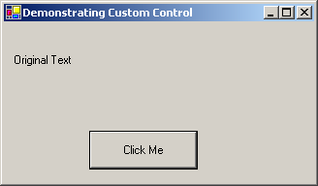
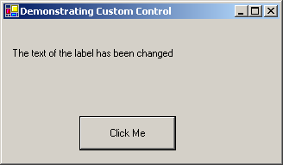
Example 1
User control that inherits from the Label control
Will expose the Text property of the constituent Label control for the consumers
Form that uses the user control can modify the Text property of the Label control in the user control

Slide 19
Example 1 Contd…
Create a Windows Application.
Add a User Control named UserControl1.
Add a Label control to UserControl1 and change the name of the label to lblMessage. Set the Text property of lblMessage to Original Text.
Create a public property to expose the Text property of lblMessage.
To consume UserControl1:
Create a blank form and add UserControl1 from My User Controls tab of the ToolBox. The control will get the name userControl11.
Add a Button control with the name btnClick and change the Text property of the button. as shown in the interface.
Code the Click event of the btnClick control to change the MessageText property of userControl11.

Slide 20
Handling Mails in WinForms
Namespace System.Web.Mail , help in constructing and sending emails using the SMTP mail service
The classes supported within the Web.Mail namespace are:
  MailAttachment
  MailMessage Properties: From, To, Bcc,
  Cc, Attachments, Body, Subject
  SmtpMail Property : SmtpServer
  Method : Send()

Slide 21
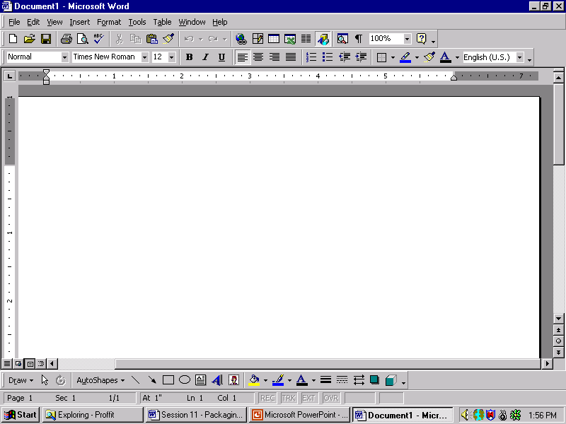
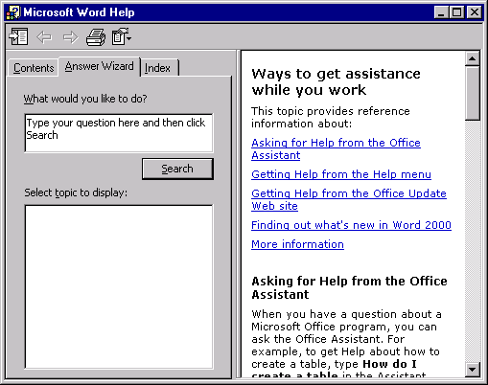

Exploring Help
How do I start ?….
I am lost…..
Now what?
Aha!!!
The Help file

Slide 22
Help Components
A typical help window consists of Content, Index and Search
Content
  Shows overall structure of information
  A mouse click leads us directly to the help topic
  Topics displayed depend on the filter applied
  List of topics is also displayed under Contents

Slide 23
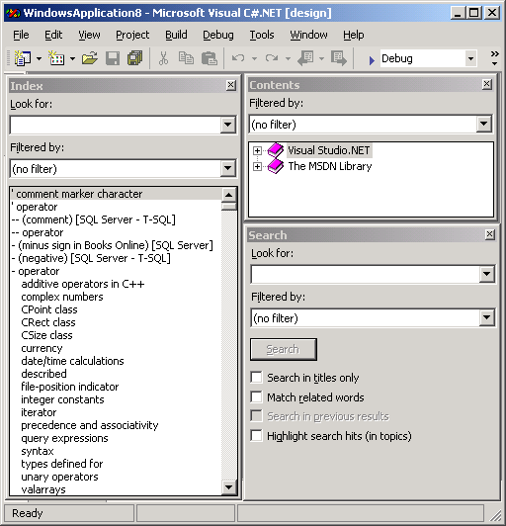
Help in Winforms
Index
Contents
Search

Slide 24
Associating Help to Applications
WinForms supports help feature using two different types: HTML File, Help on each control
Help can be associated using the following four ways :
  HelpProvider control
  Pop Up help
  ToolTip control
  HelpButton property

Slide 25



Packaging and Deploying
Packaging
  Bundling up all the files in an application into a single file
Deploying
  To move the application to the required distribution media
Deploying
Packaging

Slide 26
Deploying an Application
Mandatory
  Adding deployment project to a solution
  Setting properties for the deployment project
  Adding files and other components
Optional
  File location on client machine
  Settings for registry on client machine
  Specifying User interface
  Specifying actions
  Specifying conditions of installation

Slide 27

Modes of Packaging
Installer files
CAB file project
Merge modules

Slide 28
Installer files
Microsoft Windows Installer
Emphasizes on ‘what to install’ as compared to ‘how to install’
Removal of an application does not break another
Ability to self repair
Facility to undo an installation

Slide 29
CAB file projects
Allow creating .CAB files
Used to package ActiveX controls
Use Solution Explorer
Properties window sets Properties
While setting properties of CAB, we can specify
  Authenticode signing
  Level of compression
  Display name
  Version information
  Location of dependent files on the web

Slide 30
Merge Modules
Windows Installer is used
Consist of components like .dll files
Components cannot be directly merged
Eliminate version conflict
Merge module holds details
Share components between multiple deployment projects
Merge Module is used when components or files are shared between multiple applications

Slide 31
Adding a deployment project to a solution
States where and how our solution is going to be deployed
Steps for creating new deployment project:
  Add a new project to the solution
  Select the Setup and deployment Project folder
  Select the required type of deployment

Slide 32

Steps for Adding Files to the Deployment Project
Open the File System Editor
Create or choose the folder to install file
Click Project Output or File from the Action →Add menu
Select the item that needs to be added from the dialog box

Slide 33
Adding a Component or Merge Module
In the Solution Explorer, select the deployment project
Click Component or Merge Module from the Project → Add menu
Select the item that needs to be added from the dialog box

Slide 34
File Installation Management
The File System Editor is used to add and mention the location of the files and components to the deployment project
File System Editor displays a default standard set of folders
Sub-folders and top-level custom folders can also be added

Slide 35
File Types Management
The File Types Editor is used to setup file associations on the client computer
Application
file
File Extension is correlated with the application and action to be performed on the file

Slide 36
User Interface Management
User Interface Editor is used to identify and set properties of predefined dialog boxes used during installation
The User Interface Editor consists of a tree control with two actions:
  Install
  Admin

Slide 37
Custom Action Management
The Custom Action Editor is used to mention actions to be performed at the end of the installation
The custom actions are compiled as a .dll file, .exe file, script file or an assembly
The four folders provided by Custom Action Editor are:
  Install
  Commit
  Rollback
  Uninstall

Slide 38
Launch Condition Management
Criteria to be met so that an installation can run successfully are specified using Launch Conditions Editor
Searches and conditional checks are executed at the beginning of an installation.
They are executed in the same order as they are displayed in Launch Conditions Editor.

Slide 39
Summary
Custom Controls are user-defined controls that are created with the help of the built in controls of WinForms.
A custom control is derived from a UserControl class or a Control class, or an existing Windows Forms control.
The steps involved in handling events are:
  Defining an Event
  Subscribe objects to that event
  Notify subscribers of the event (when it occurs)
System.Web.Mail contains classes that help in constructing and sending emails using the SMTP mail service
The classes supported within the Web.Mail namespace are:
  MailAttachment
  MailMessage
  SmtpMail
One of the most important parts of any application is the Help file for that application.

Slide 40
Summary Contd…
The term packaging implies bundling up all the files in the application into a single file called a distribution unit. Packaging an application makes it easier to deploy and install the application on the client side.
The categories of properties for deployment projects are General project properties and Configuration-dependent properties.
File System Editor is used to add files, project outputs and other components to the deployment project and to mention the location where they will be installed on the client machine.
User Interface Editor is used to identify and set properties of predefined dialog box that will be displayed during installation on the client computer.
Custom Action Editor is used to mention additional actions that need to be performed on the client machine at the end of the installation.
Custom Action Editor provides four folders, each associated with a phase of installation. These folders are Install, Commit, Rollback and Uninstall.
The criteria to be met so that an installation can run successfully are specified using Launch Conditions Editor.

